Slide 1
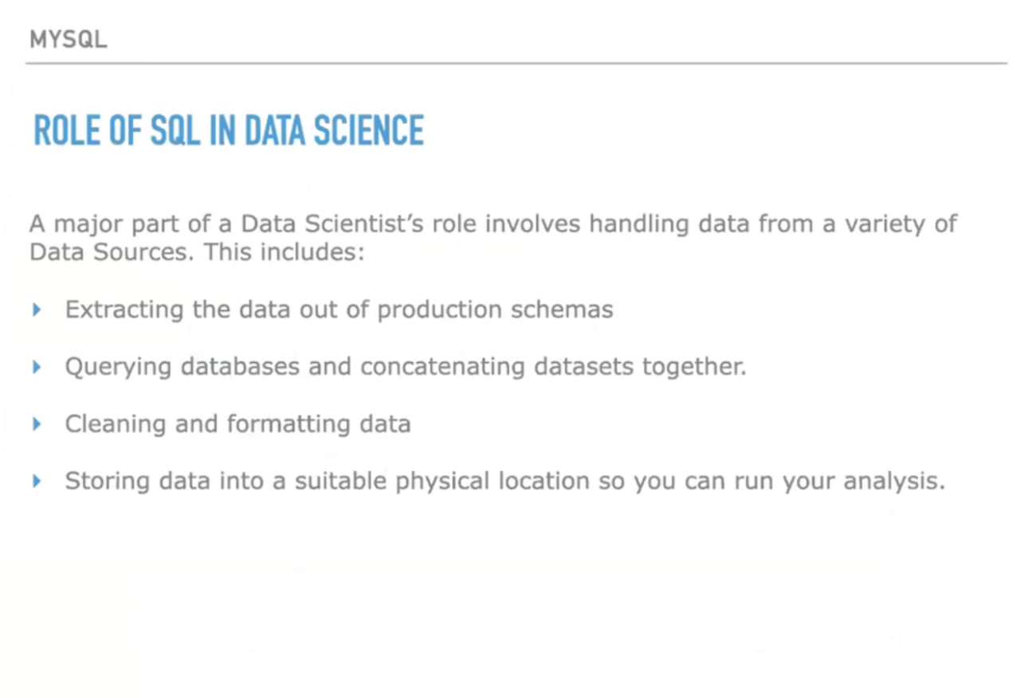

Slide 2
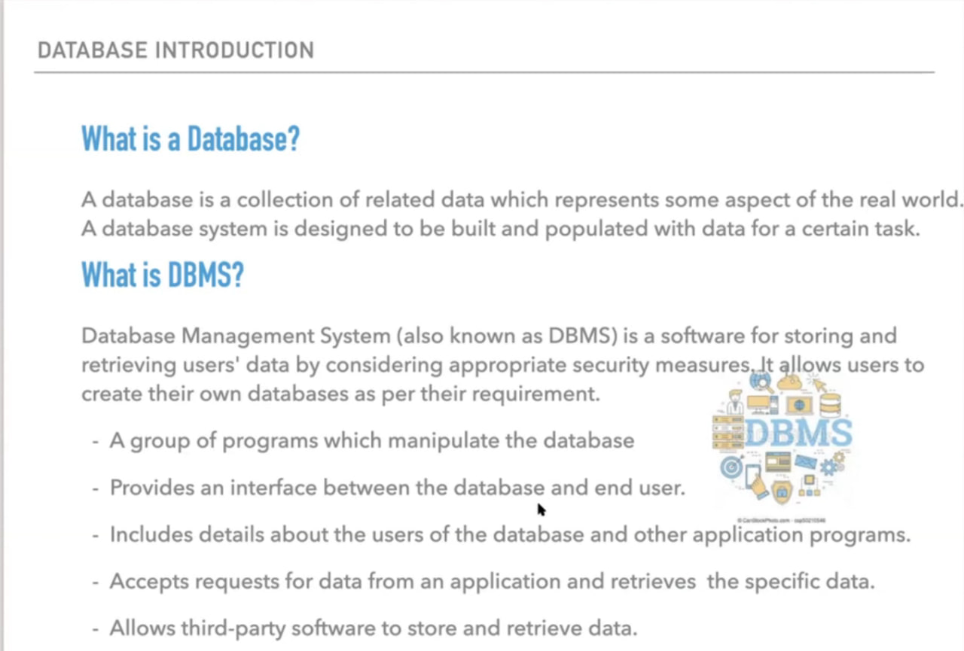

Slide 3
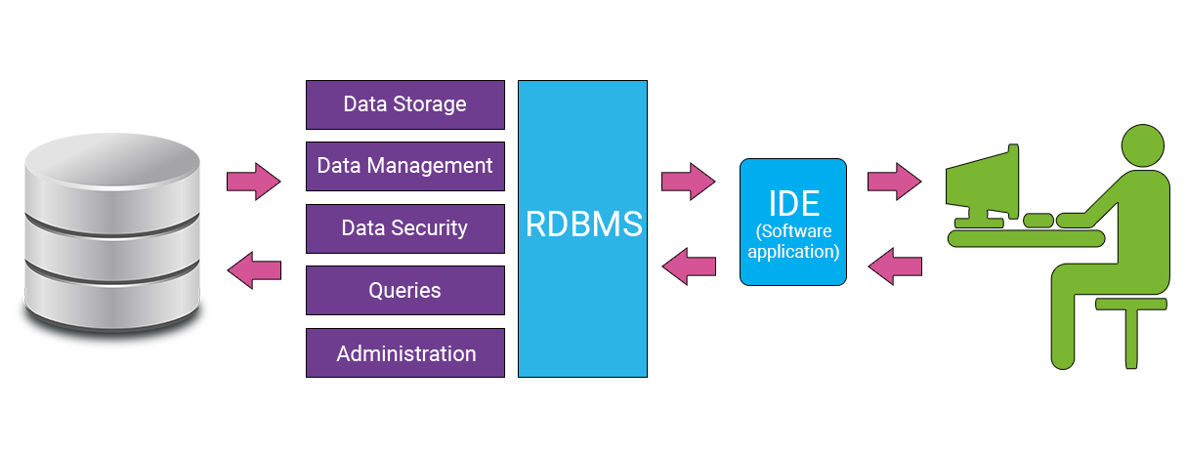

Slide 4
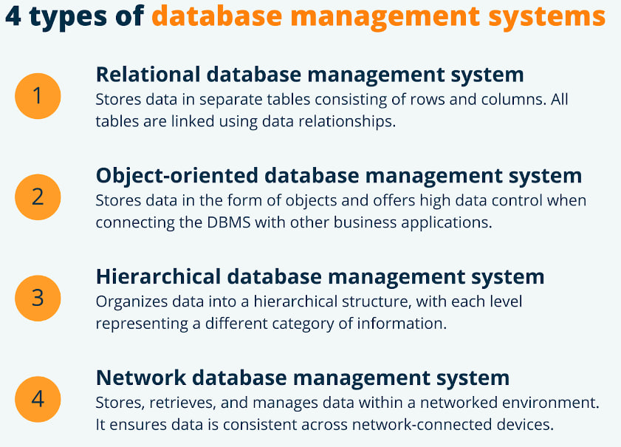

Slide 5
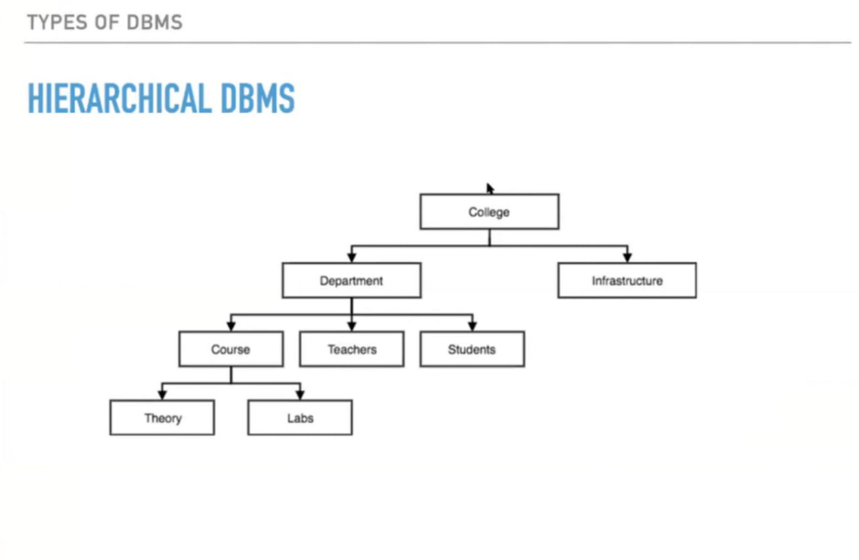

Slide 6
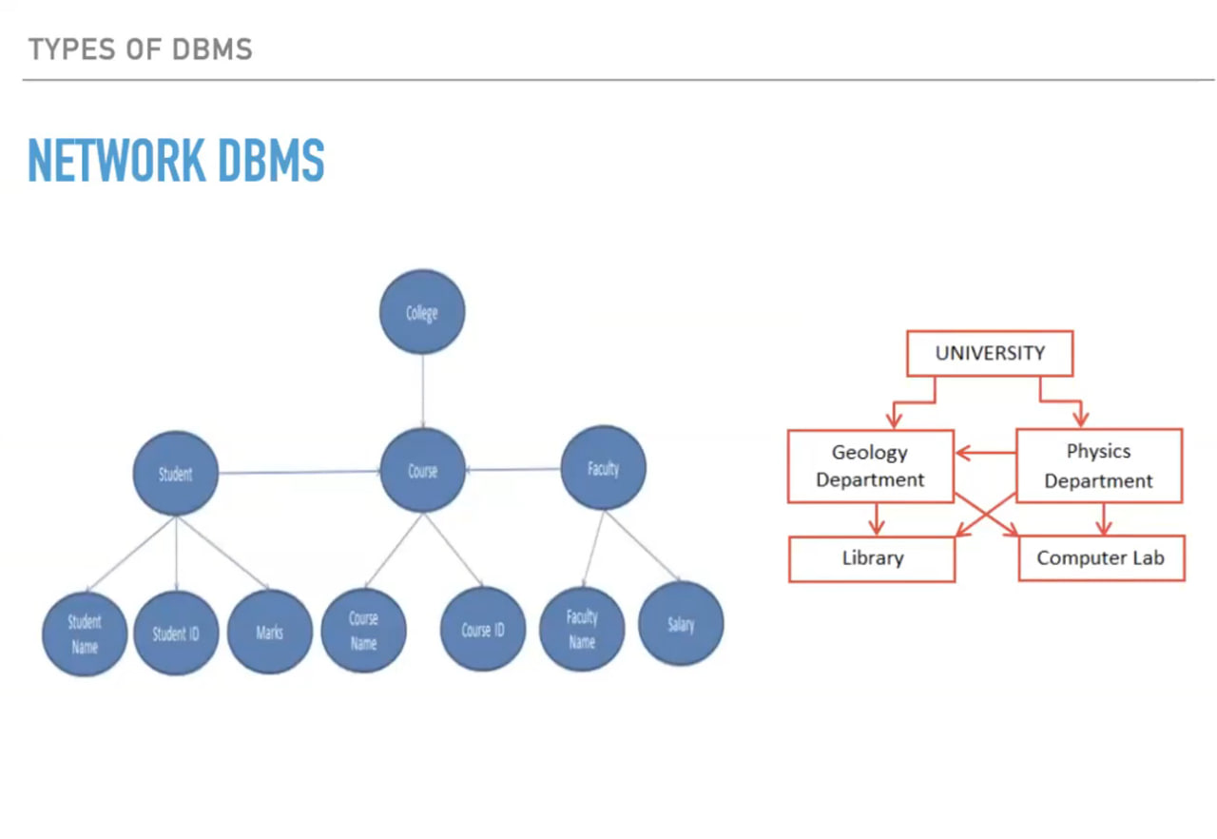

Slide 7
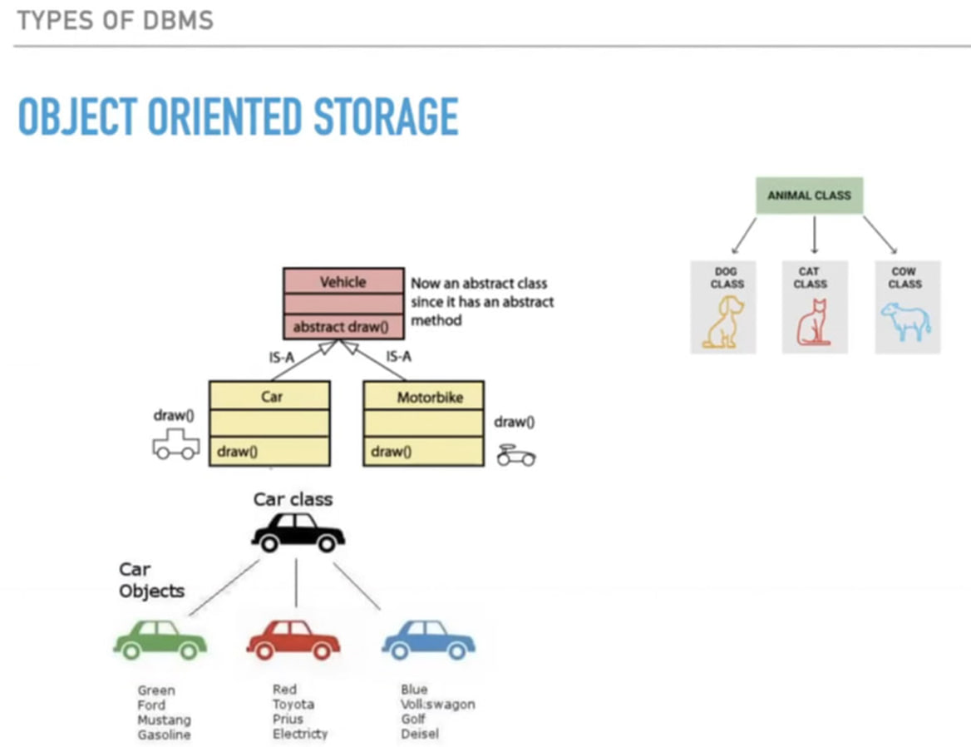

Slide 8
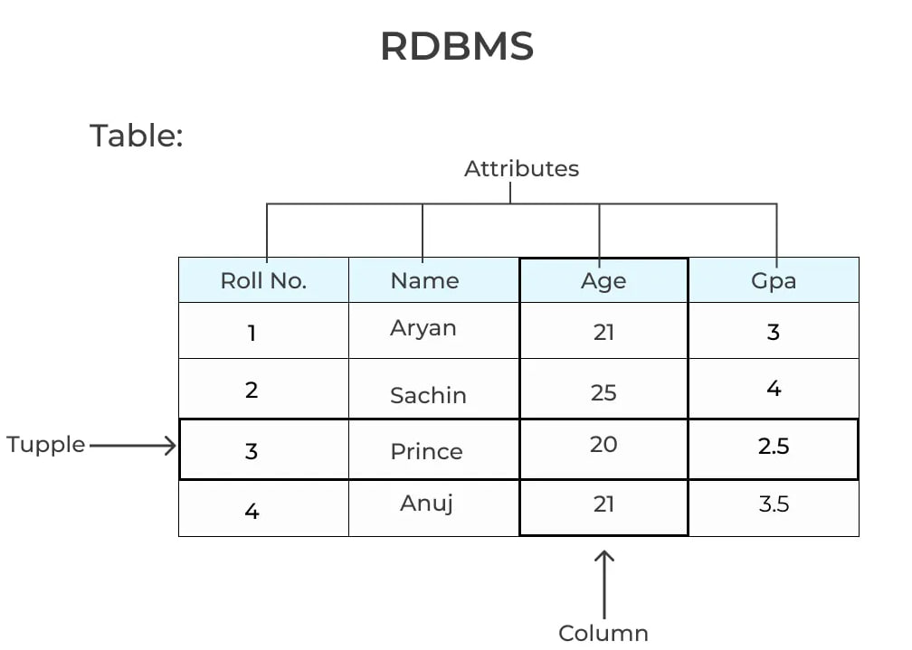

Slide 9
Relational database
Oracle
Informix
Access
SQL server
PostgreSQL
MySQL

Slide 10
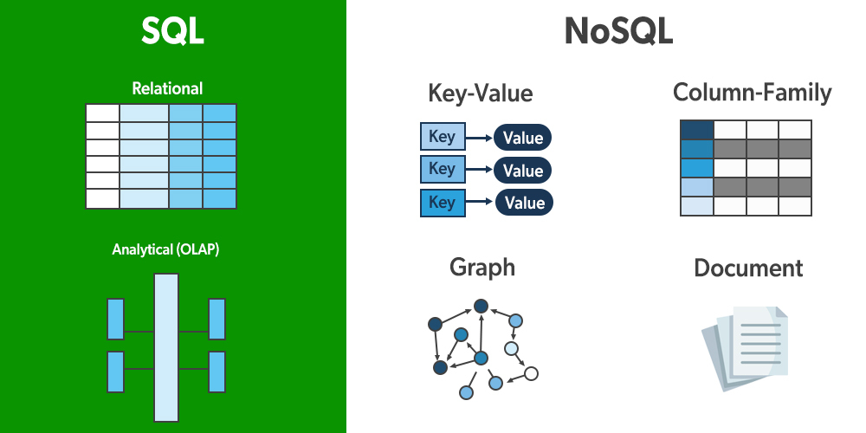
Difference between NoSQL Databases and SQL Databases:
NoSQL database schema is flexible while SQL database schema is rigid.
In NoSQL databases, queries are more immediate than SQL databases.
NoSQL databases are non-relational while SQL databases are relational.
NoSQL Examples -HBase, Bigtable.
SQL Examples- Sybase, Access, Oracle, and MySQL.

Slide 12
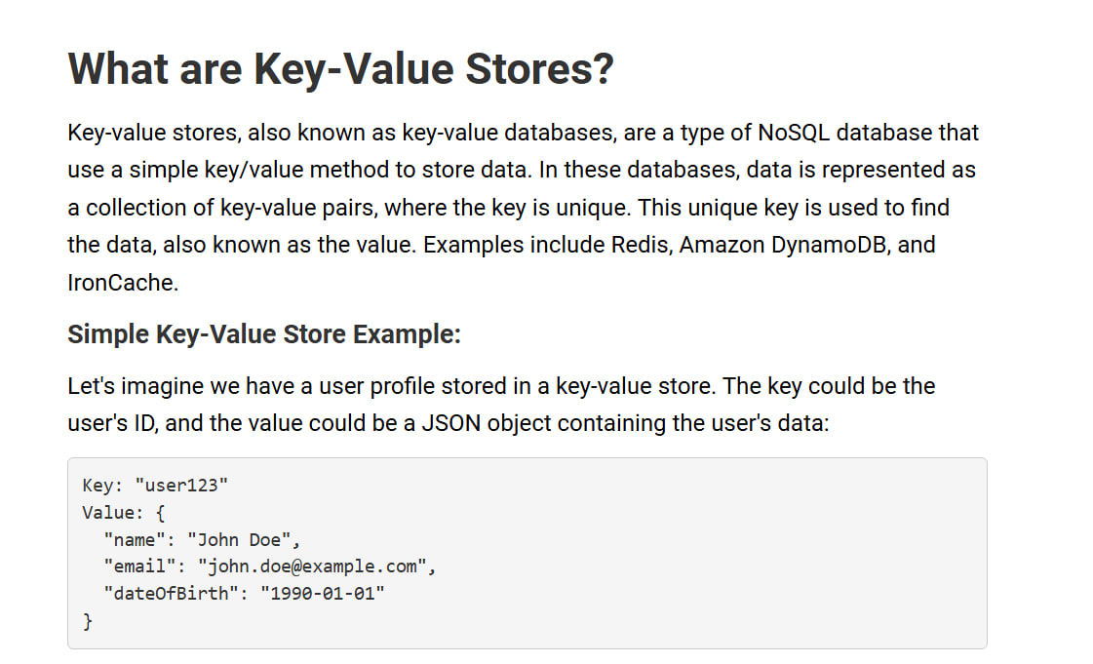

Slide 13
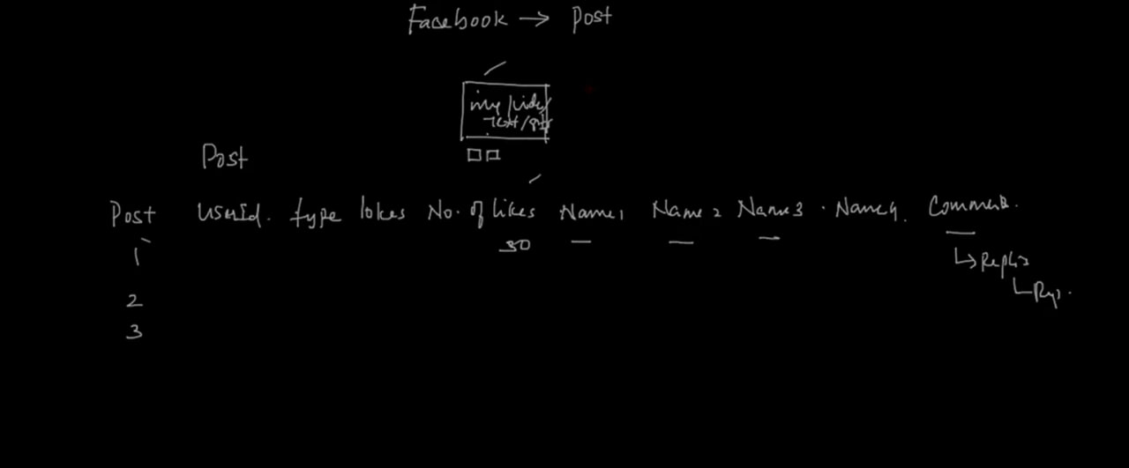
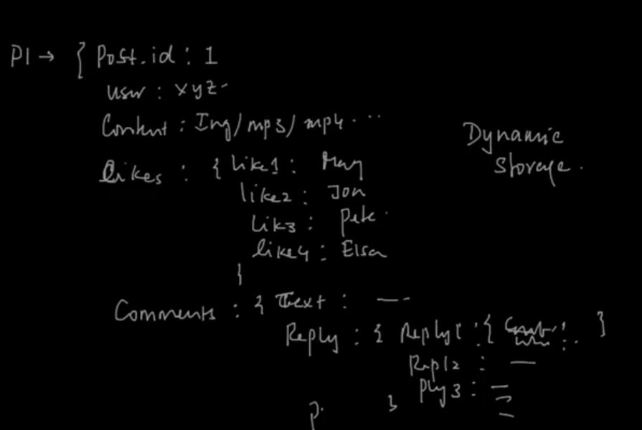

Slide 14
No SQL DBMS
Key –Store ---> Redis
Document ---> MongoDB
Graph ---> Neo4j
Wide Column ---> Cassandra, Hbase

Slide 15
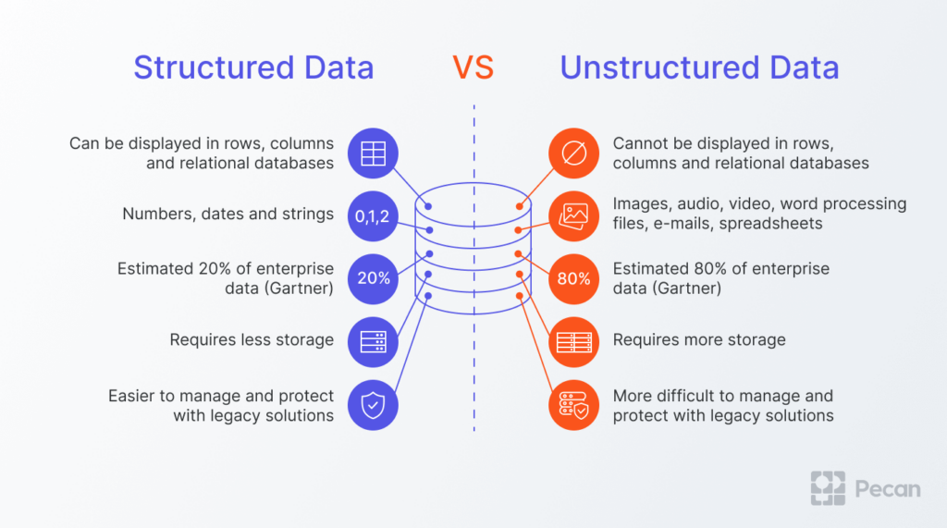

Slide 16
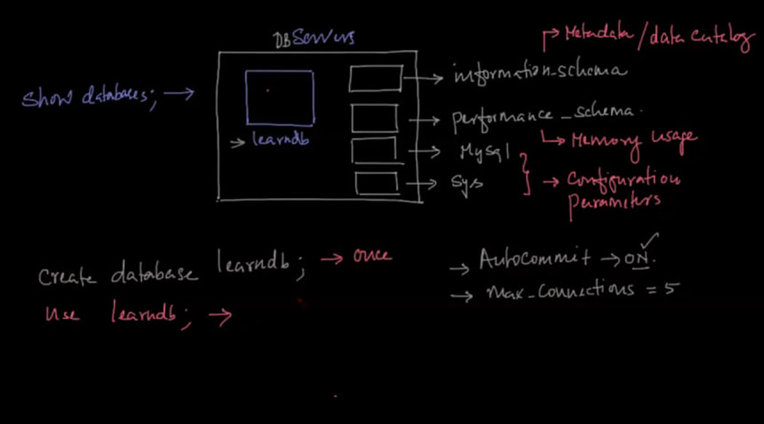

Slide 17
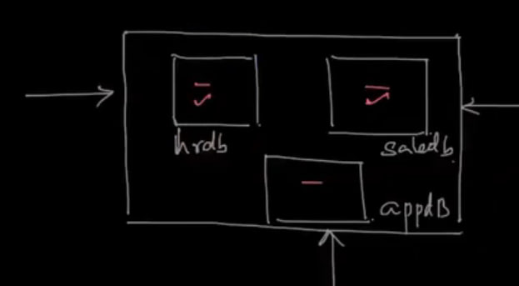

Slide 18
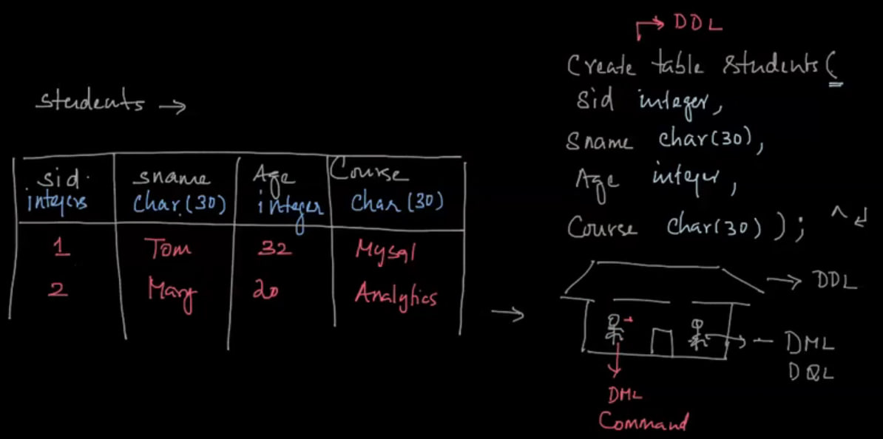

Slide 19
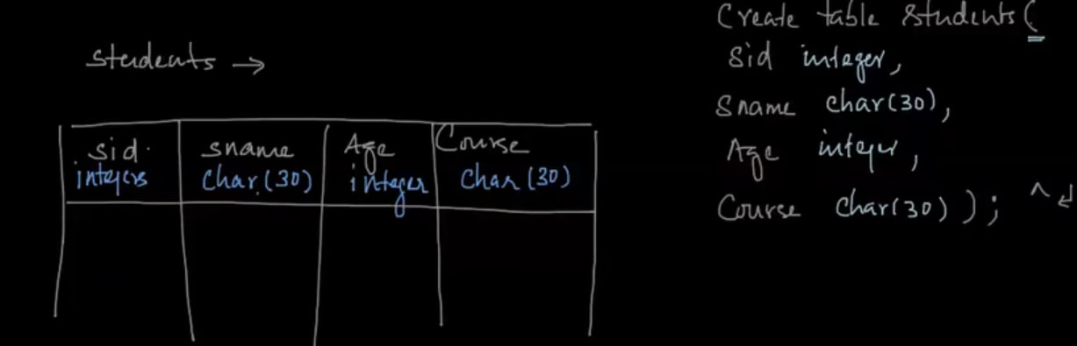

Slide 20
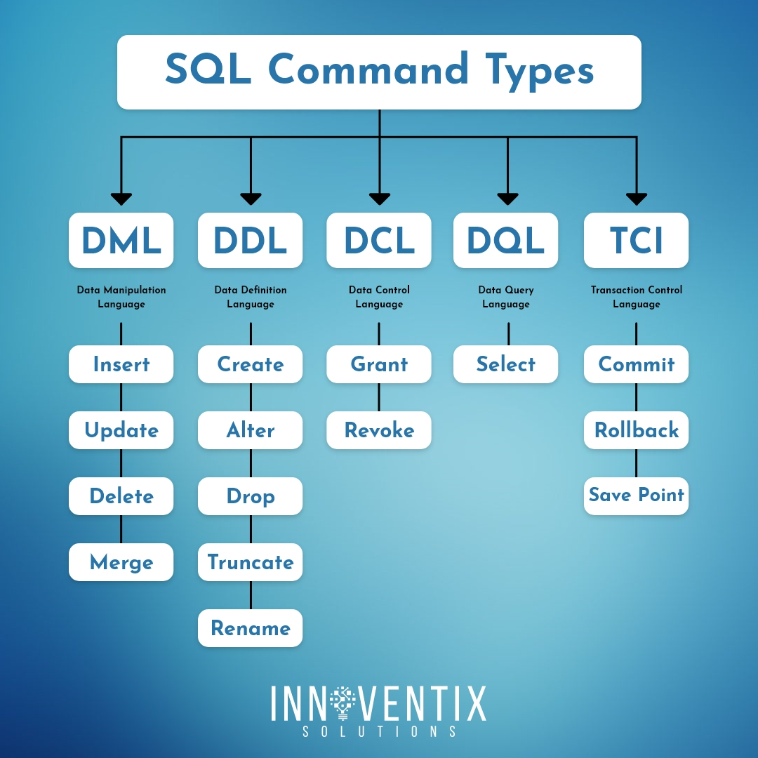

Slide 21
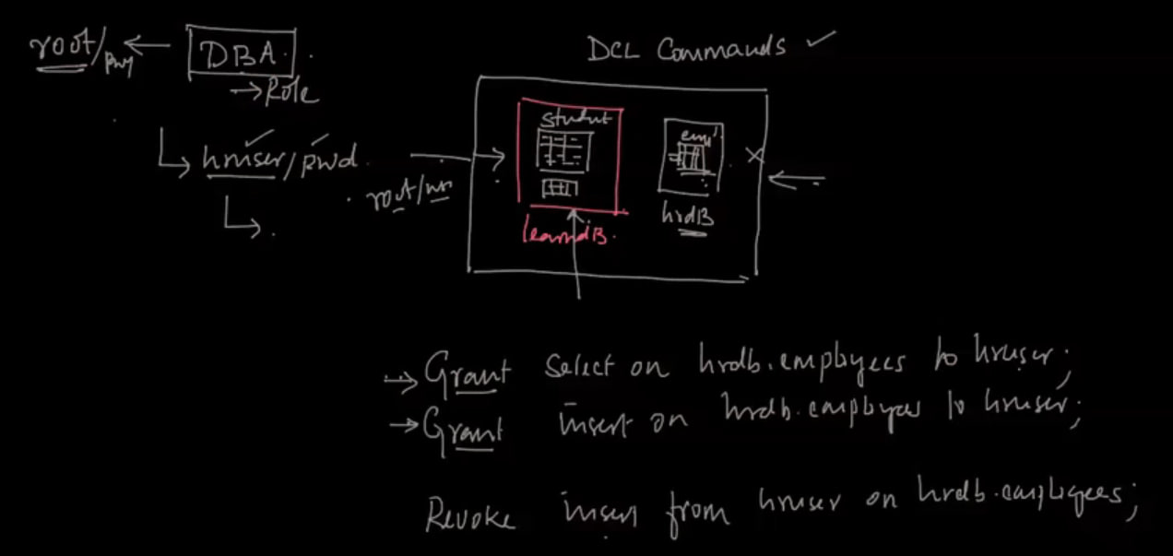

Slide 22
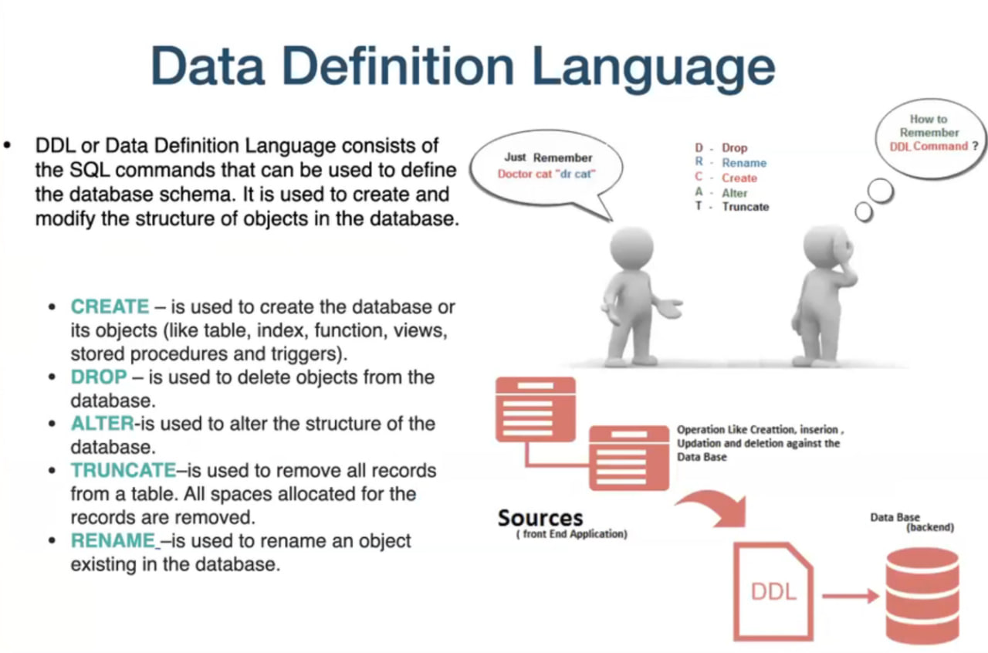

Slide 23
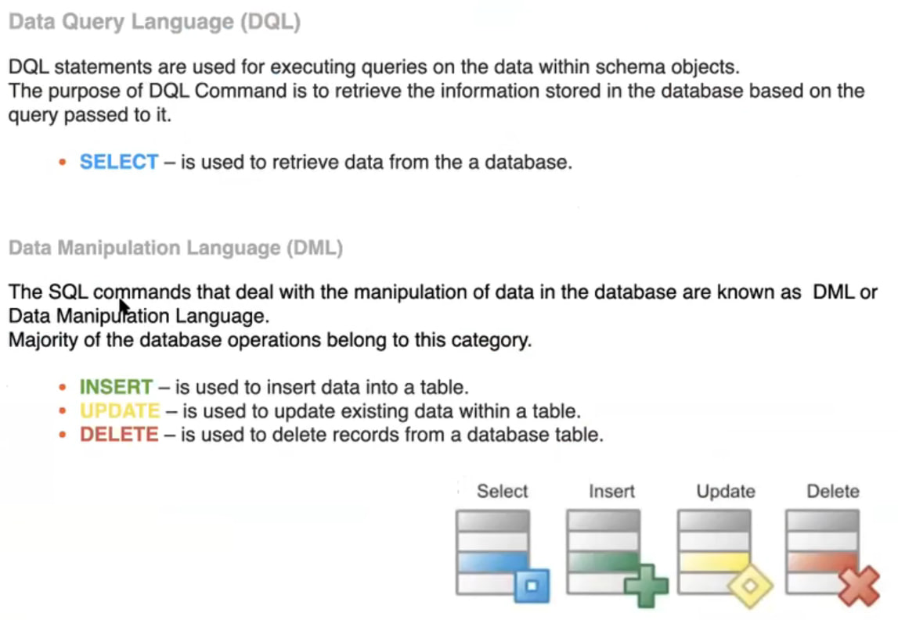

Slide 24
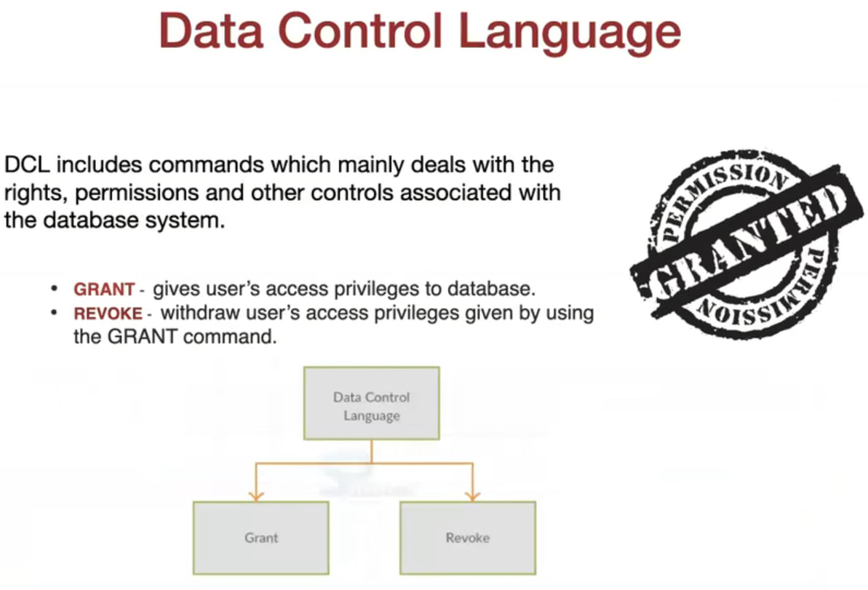

Slide 25
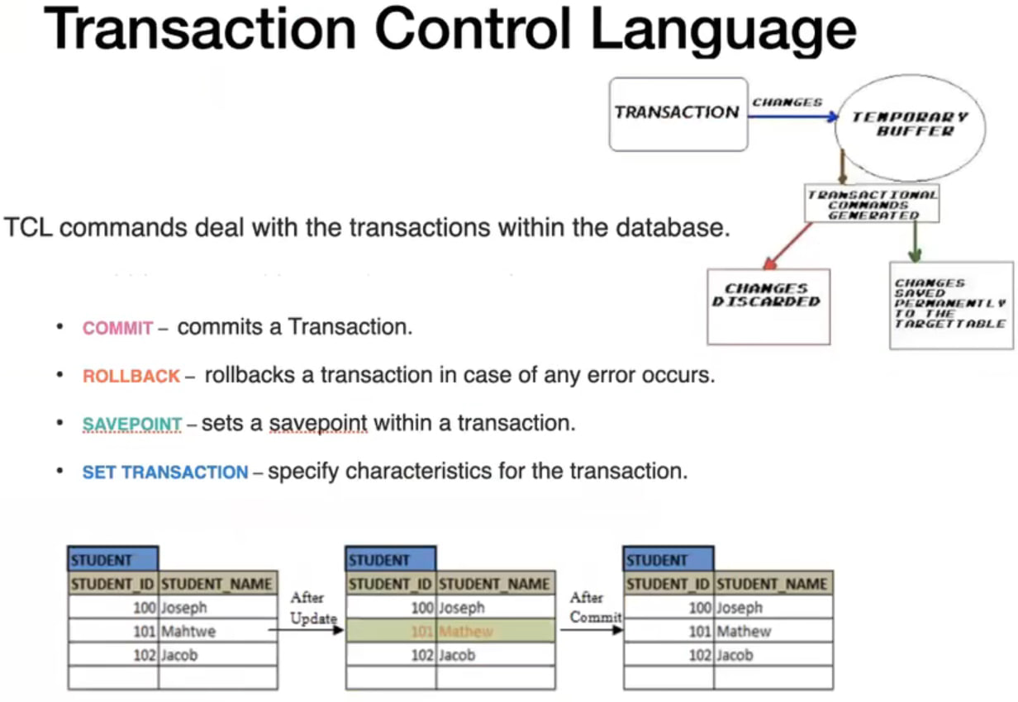

Slide 26
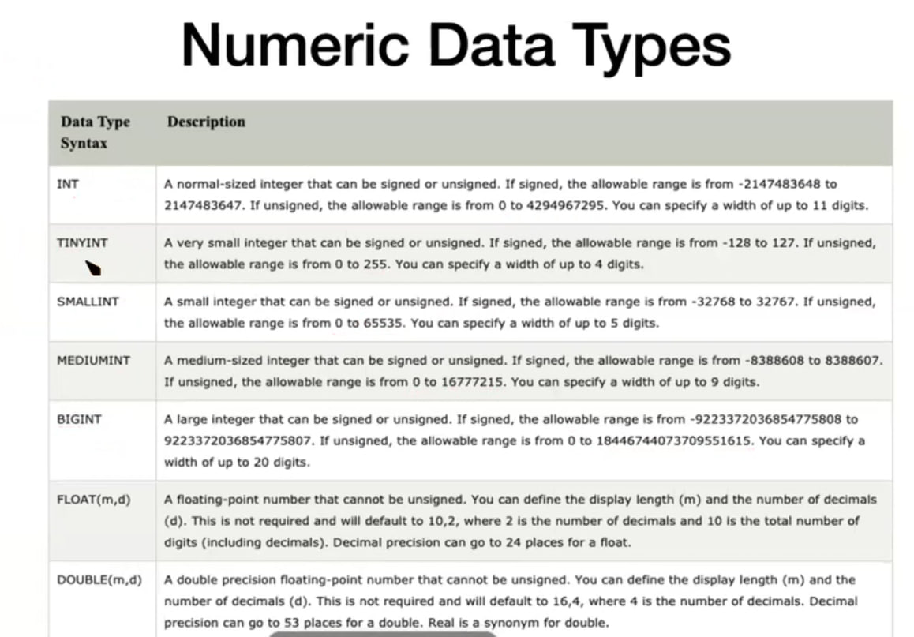

Slide 27
Small Int 2^16 = 65536
Medium Int 2^24 = 16777216
Int 2^32 = 4294967296
Big Int 2^64 = 18446744073709551616
Float Decimal

Slide 28
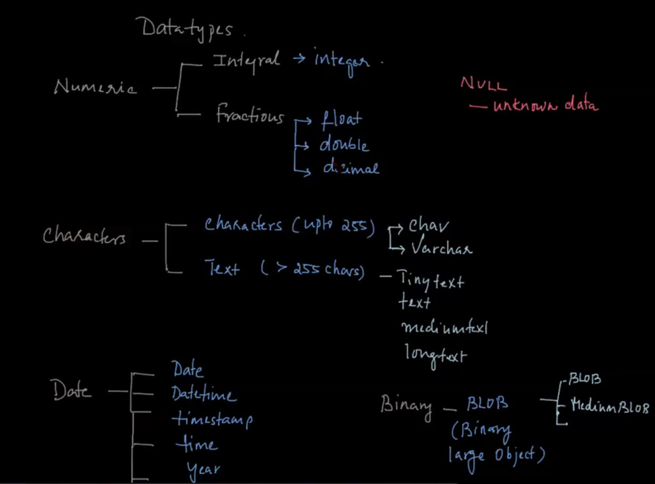

Slide 29
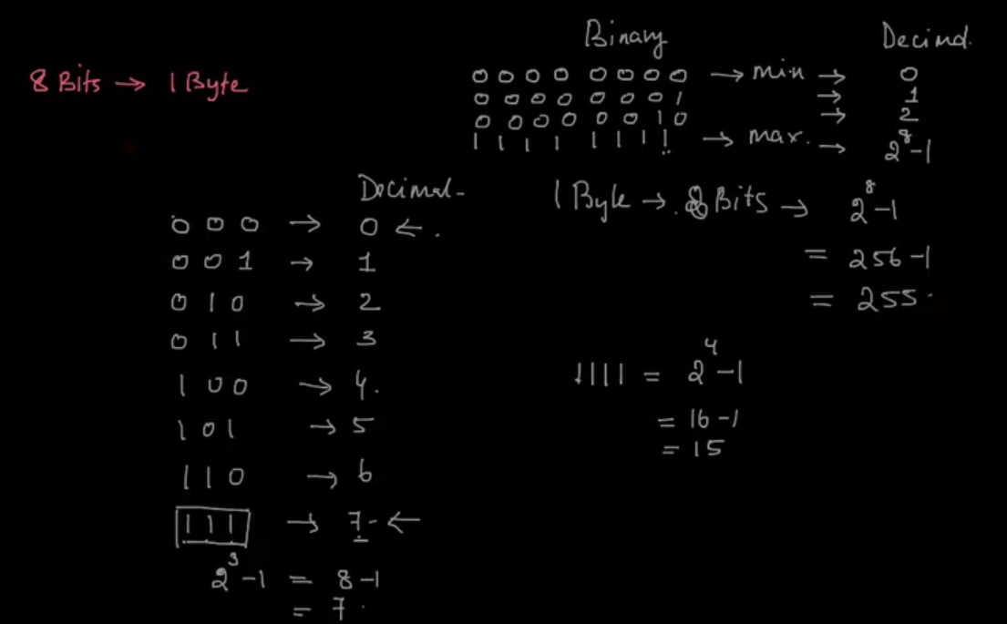

Slide 30
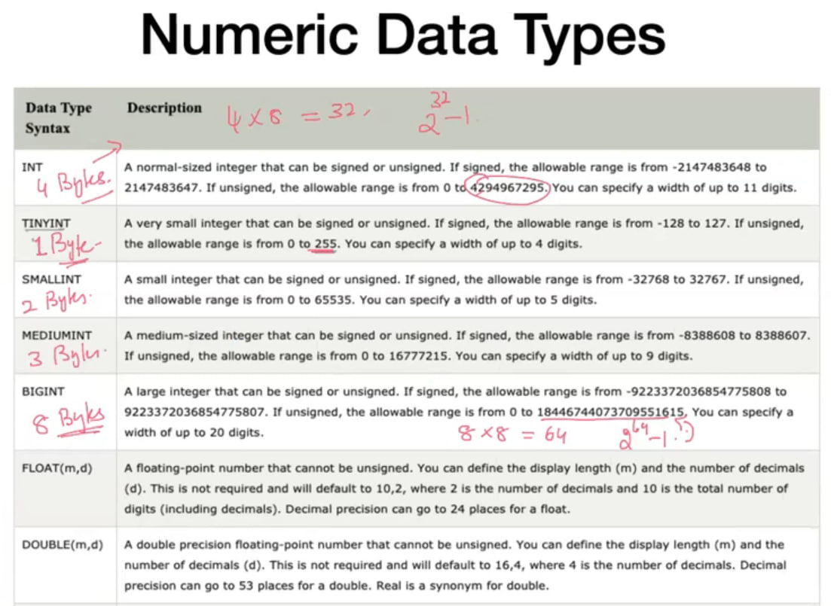

Slide 31
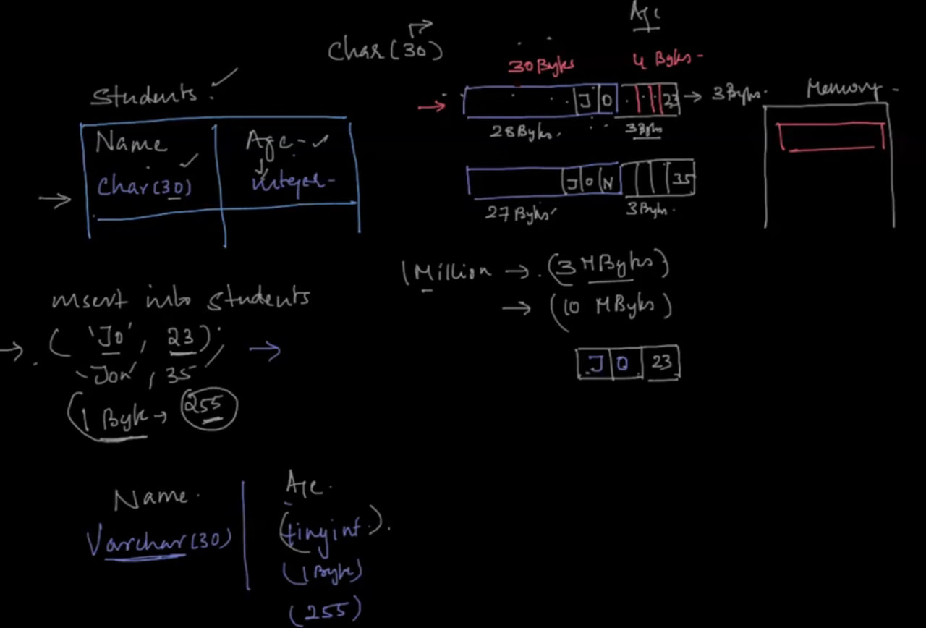

Slide 32
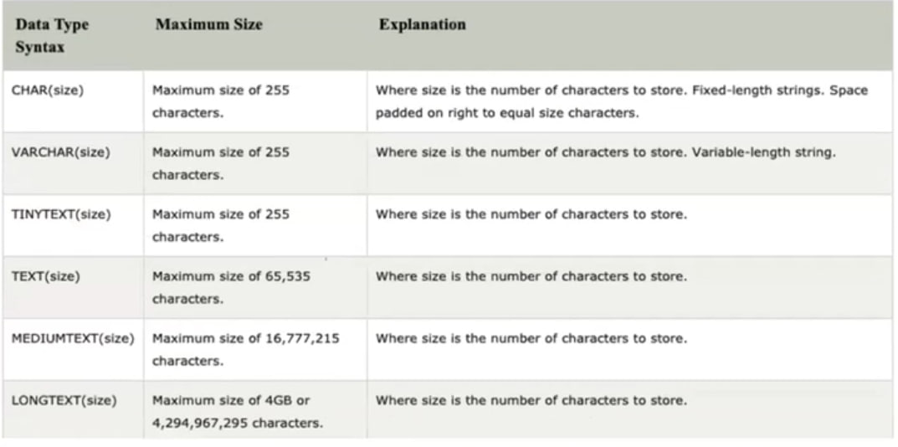

Slide 33


Slide 34
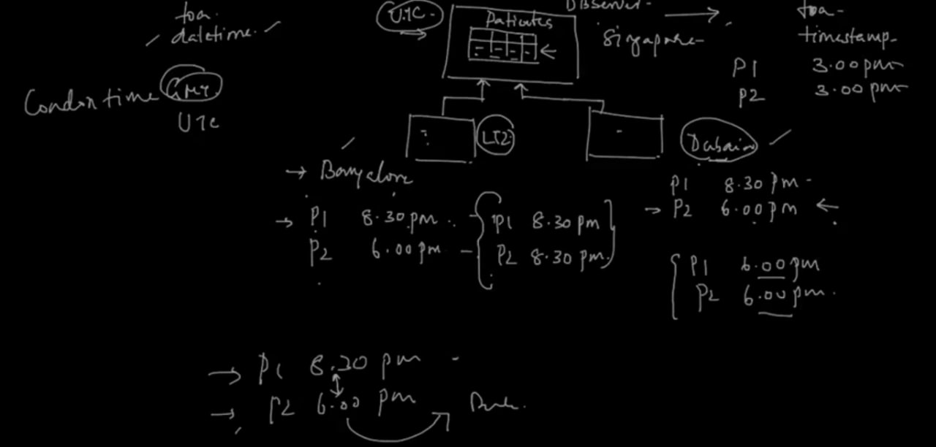

Slide 35
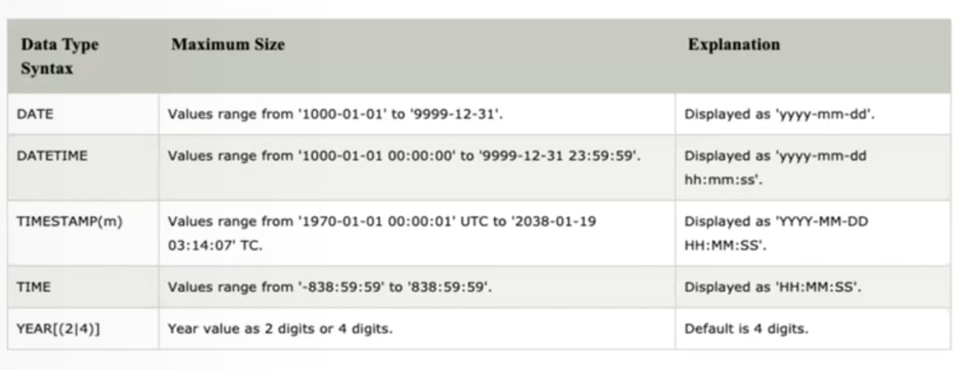

Slide 36
Data analysis
It is the process of reviewing, cleansing, and organizing data to find patterns and trends. Better decisions can be made with this knowledge in a variety of industries, including marketing, technology, healthcare, and finance.
Here’s how it works:
Cleaning Up the Data: Analysts begin by correcting any mistakes or discrepancies in the data. This guarantees the accuracy of the outcomes.
Shaping the Data: Next, they convert the unprocessed data into more easily analyzed format, such as tables or charts.
Modeling the Data: Lastly, they generate predictions and find patterns in the data by using models and formulas.

Slide 37
Who is a Data Analyst?
A data analyst is a professional skilled in processing and performing statistical analyses on data. They extract meaningful insights from data sets, translate numbers and data into plain English, and help organizations make informed decisions based on data.
Some of the key responsibilities of a data analyst:
Collecting and organizing data from various sources.
Conducting thorough data analysis to identify trends, patterns, and outliers.
Developing and implementing data models and statistical algorithms.
Creating visualizations and reports to present findings.
Collaborating with stakeholders to understand their data needs

Slide 38
SQL (Structured Query Language)
SQL :--- to store, update, remove, search, and retrieve information from the database. You can also use SQL to maintain and optimize database performance.
It used in data integration, combining data from various sources or tables for analysis.
SQL uses wide range of mathematical and statistical functions, such as SUM, AVG, MAX, count MIN etc
PostgreSQL, Microsoft SQL Server, MySQL, SQLite, and IBM Db2 are some of the top SQL databases used in data science.

Slide 39
Data manipulation
SQL provides tools for transforming and cleaning datasets, including merging datasets, creating new columns, and applying mathematical functions.
Data integration
SQL can combine data from different sources or tables to enable comprehensive analysis.
Mathematical and statistical functions
SQL provides functions like SUM, AVG, MAX, and MIN to derive insights and compute metrics within datasets.

Slide 40
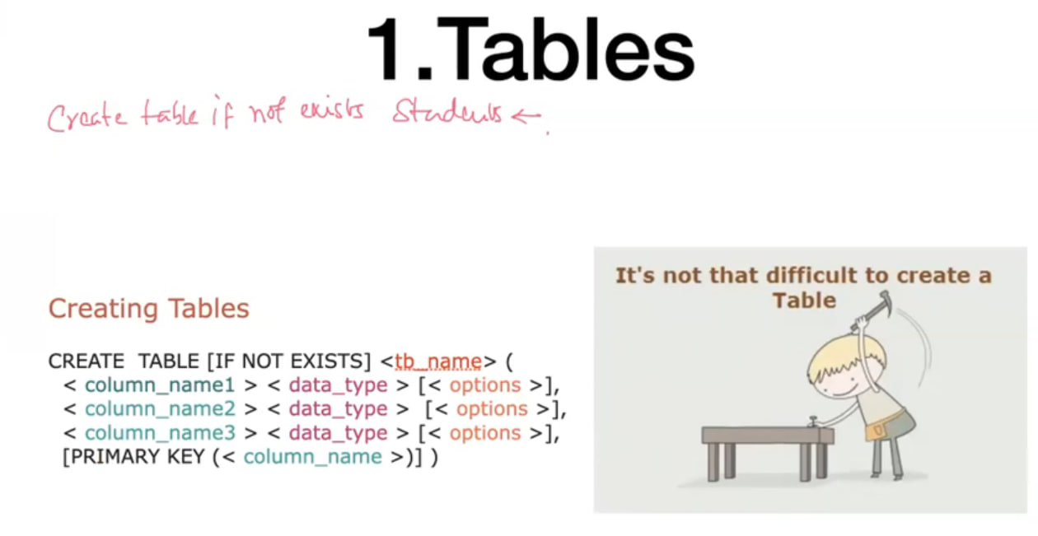

Slide 41
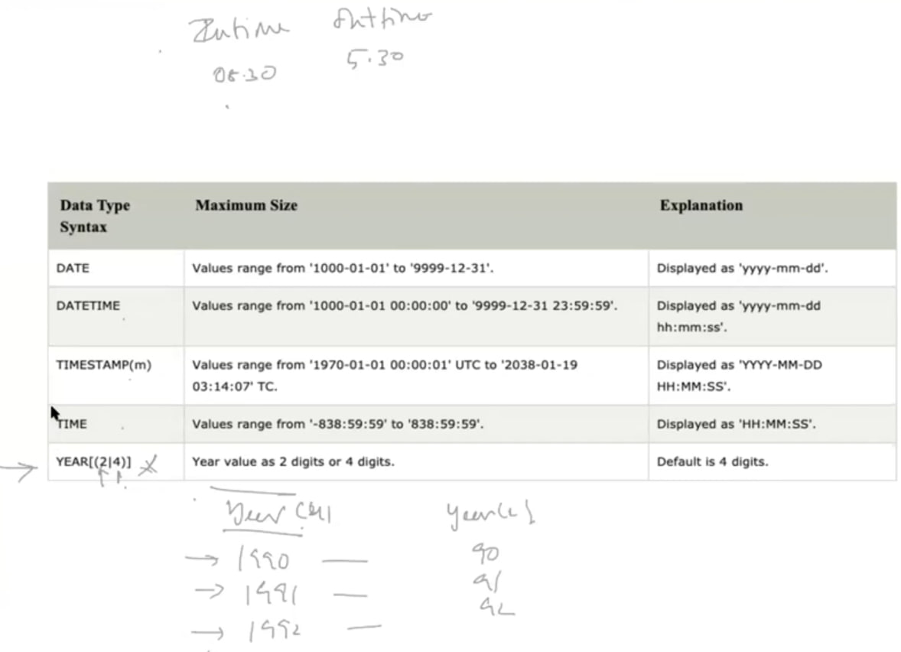

Slide 43
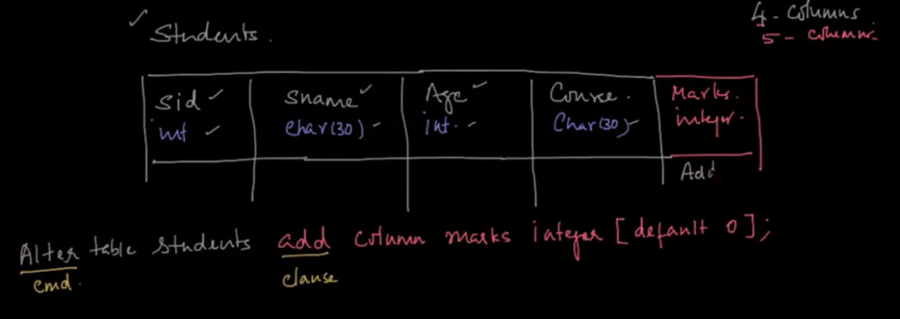

Slide 44
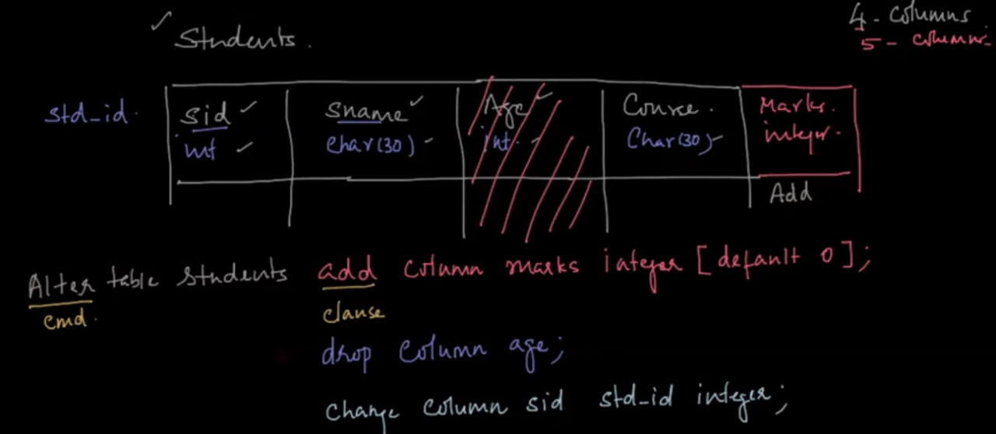

Slide 45
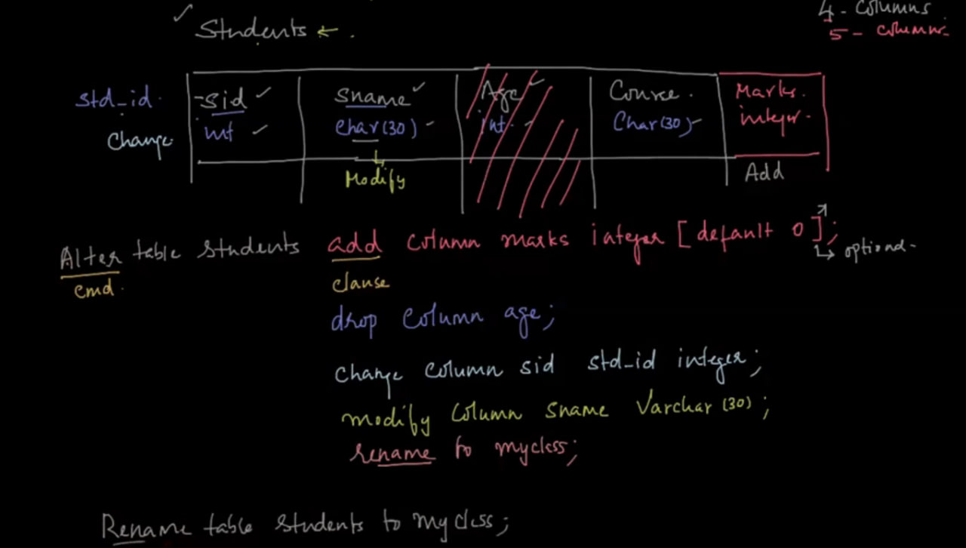
Drop table student

Slide 46
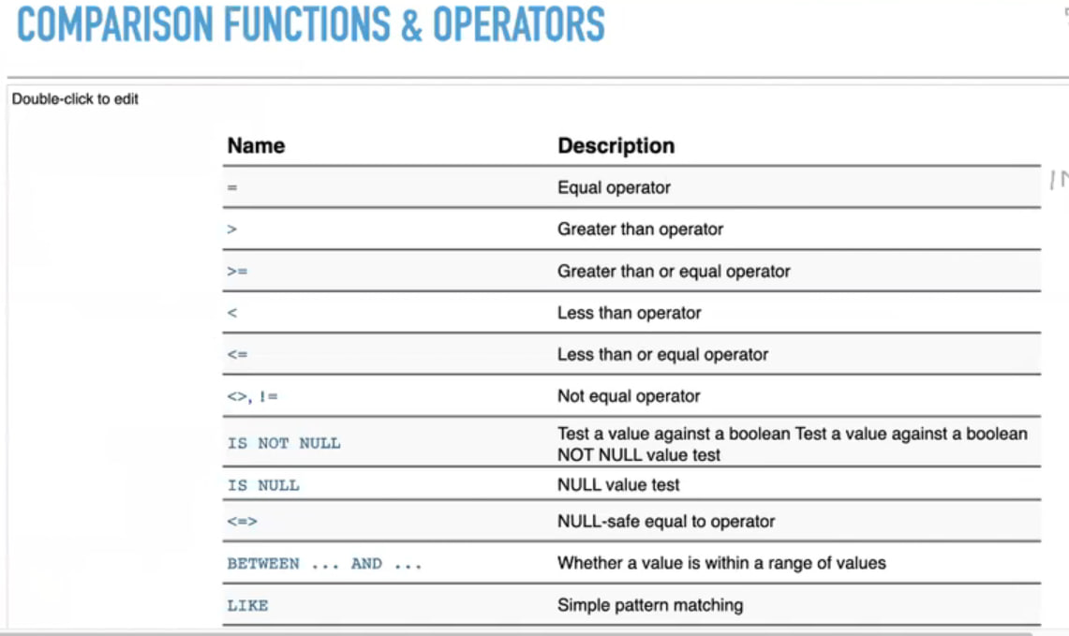

Slide 47
Where clause used for select specific record
Having clause used for specific group

Slide 48
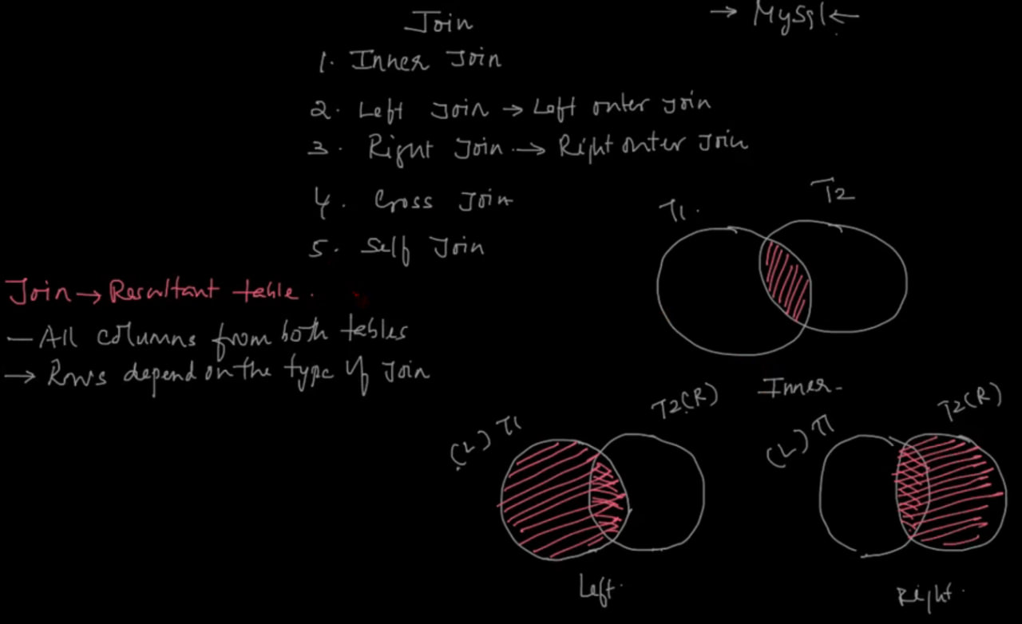

Slide 49
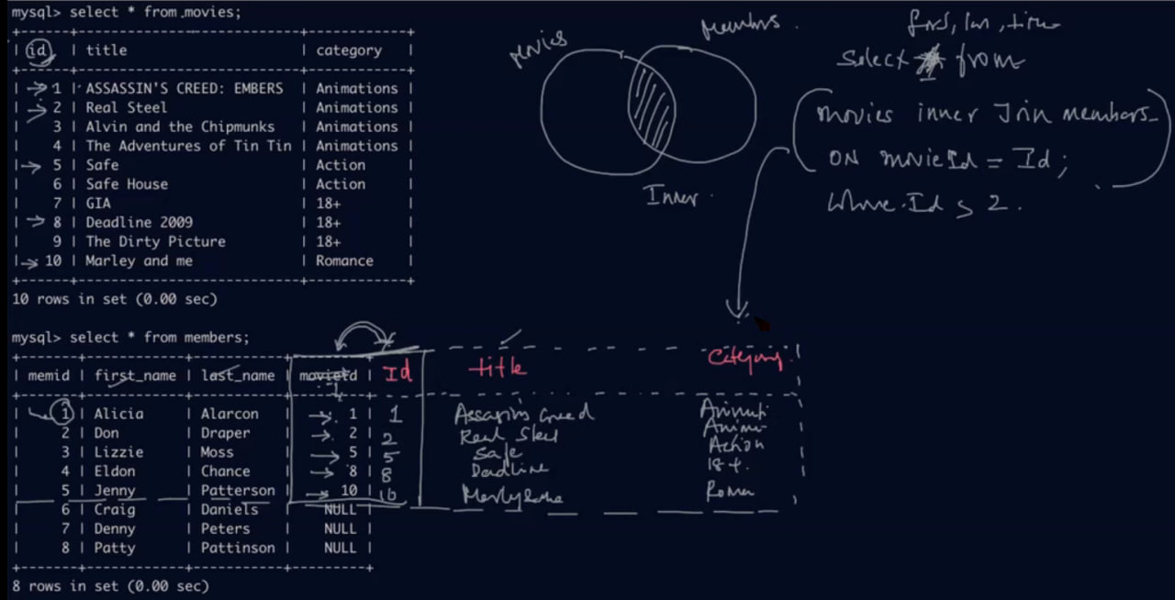

Slide 50
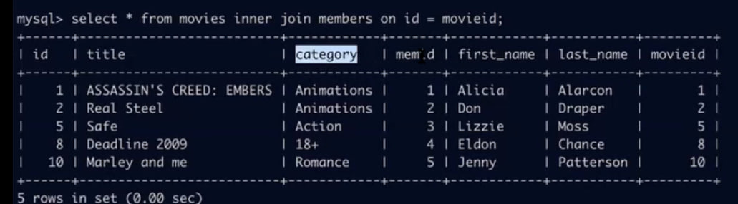
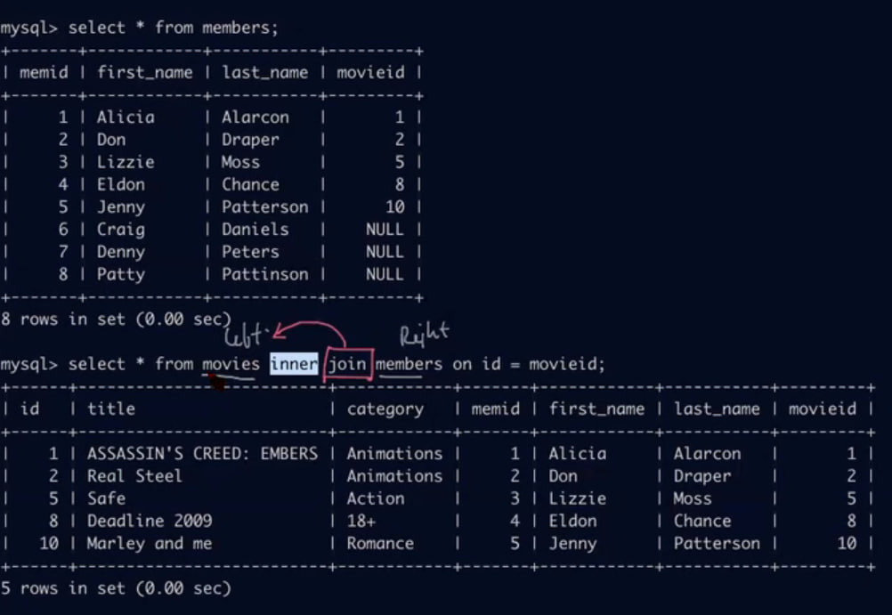

Slide 51
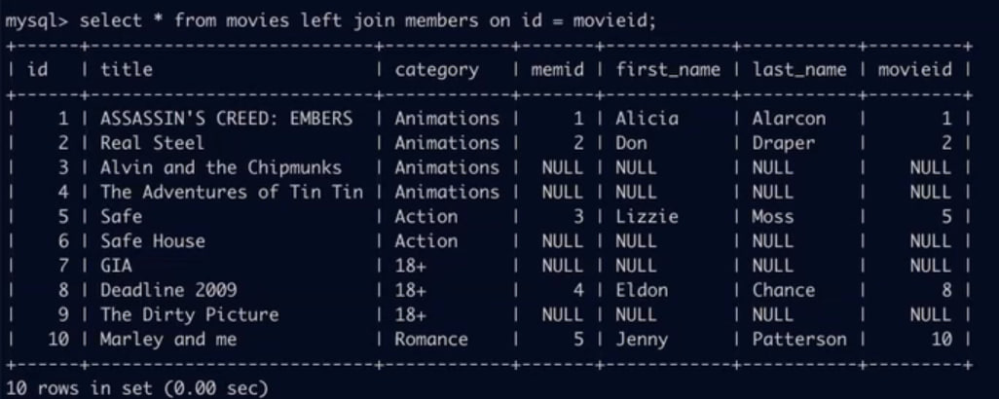
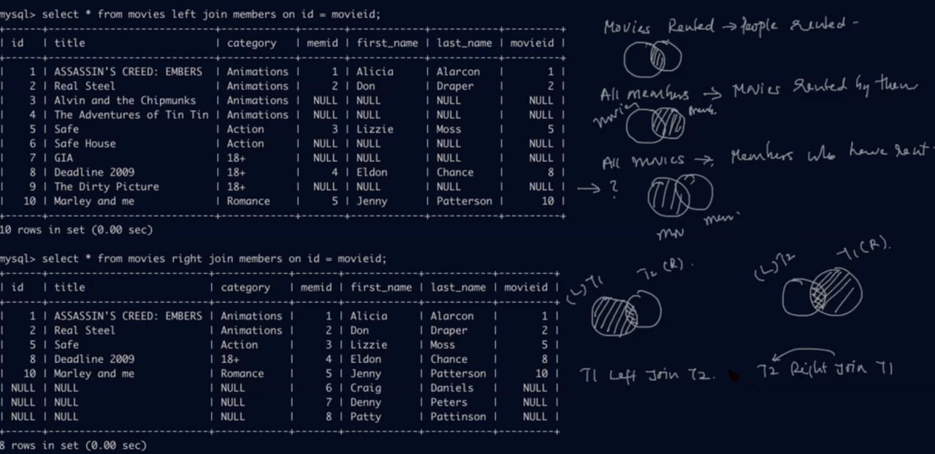

Slide 52
Constraints
3 types of constraints
Domain
Key
Referential integrity
Domain constrain involved – unique, not null, check and default
We can have single column with multiple constraints
Unique expect only unique value in column which is id related column But not every id column
Not null expect only no null value otherwise error
Check expect condition based value where we can restrict value more than or less than or equal
Default

Slide 53
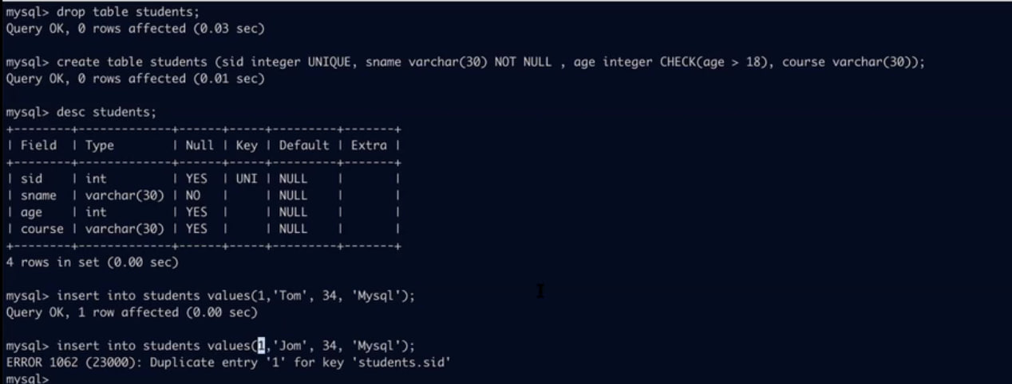

Slide 54
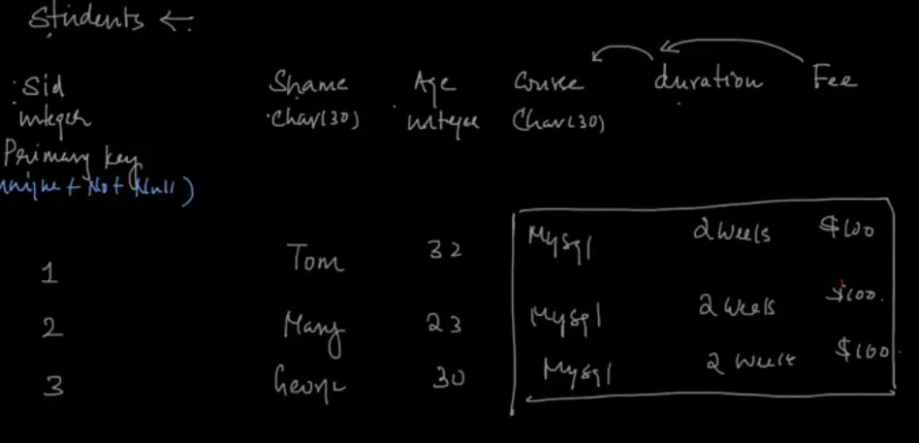
Key
There should be at least one unique value column to identify each record
Key constraint are implemented by primary key only and primary key will only one in a table and by default primary key is unique and not null

Slide 55
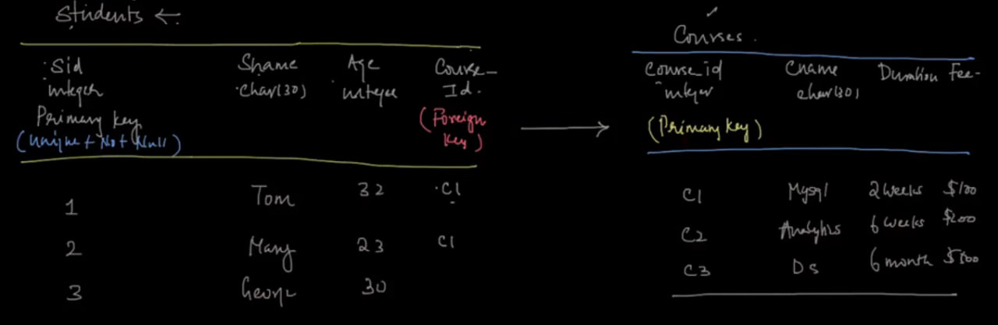

Slide 56
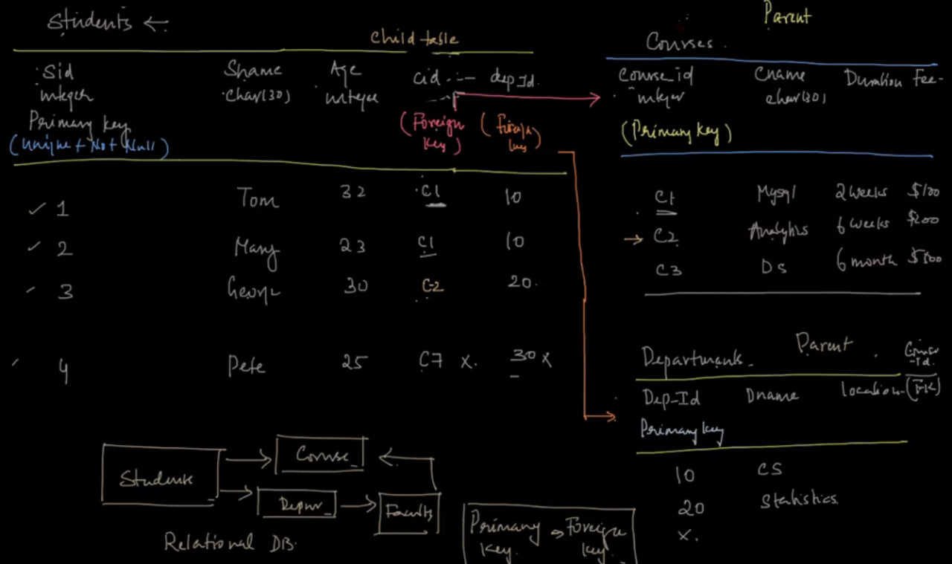
Referential integrity: a data which is not present in parent table and try to put into child table then we will get error and which is call referential integrity error

Slide 57
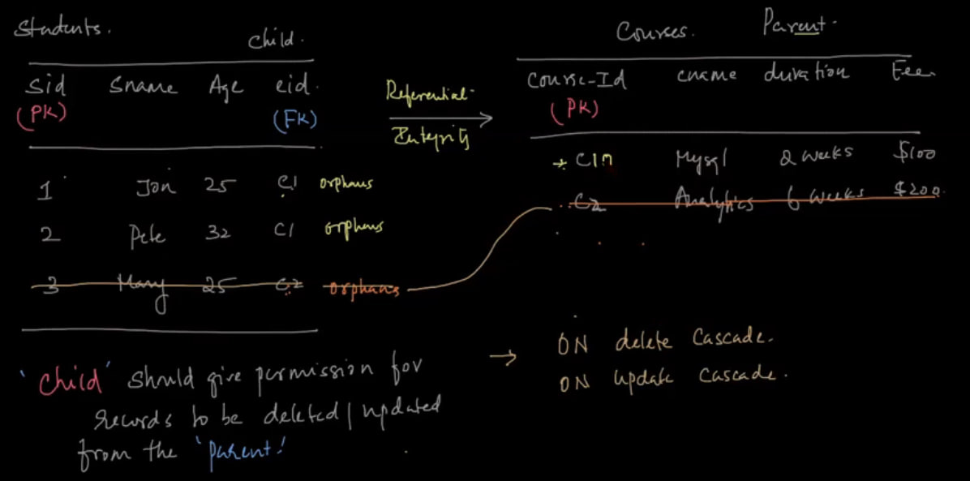
On delete cascade
On update cascade
Foreign keys should be primary key of parent table

Slide 58
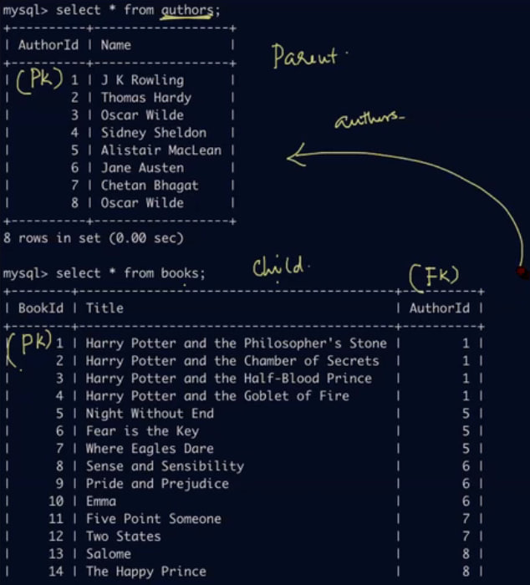
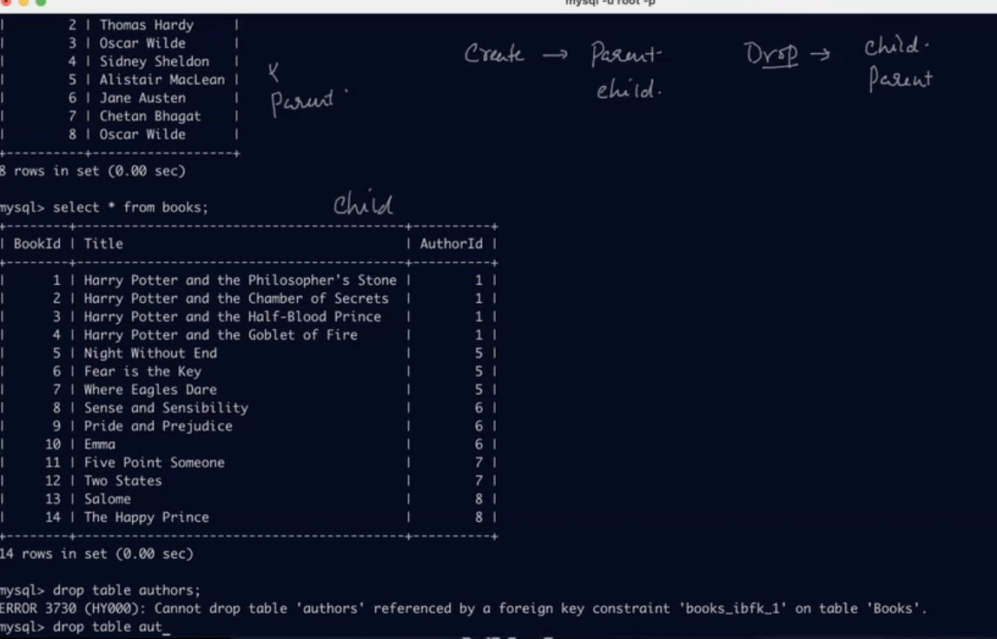


Slide 59



Slide 60




Slide 61


Slide 62





Slide 63

Durability:
This property ensures that once the transaction has completed execution, the updates and modifications to the database are stored in and written to disk and they persist even if a system failure occurs. These updates now become permanent and are stored in non-volatile memory. The effects of the transaction, thus, are never lost.

Slide 65
Database object
Table
Views
Index
Sequence
Stored procedure
Function
Triggers

Slide 66


View
Virtual table
Window of a data

Slide 67


Slide 69


